Slide 1
Auto-Labelling
Reliable Ground Truth Generation
using Layout-Aware AI + Multi-LLM Verification
Notes:
Build a fully automated pipeline that reads clinical PDFs, classifies document types, verifies the classification using multiple independent agents, and produces reliable ground truth with minimal SME effort.

Slide 2
Problem Statement
Clinical PDFs are complex:
Multiple document types inside one PDF
Embedded reports inside clinical notes
Mention Only information present in a document
Tables, multi-column layouts, headers
Making extracting entities tougher.
LLMs make classification errors: wrong labels, fabricated evidence, inconsistent confidence scores
Manual review at scale is expensive and slow because of large doc.
Need:
automated, rigorous quality control before any classification is accepted

Slide 3
Philosophy: Context over Keywords
We classify documents using:
STRUCTURE
ANCHORS
EVIDENCE
SEGMENT COVERAGE
NOT keywords.
“Context over keywords — distinguish primary reports from narrative discussion.”

Slide 4
Core Goal:
correctly detect logical document segments.
assign multiple document labels per segment.
quantify how much of each label is present.
validate classification through independent LLM calls.
automatically correct inconsistencies .
escalate only genuinely ambiguous cases to SMEs.
generate high-quality ground truth at scale.

Slide 5
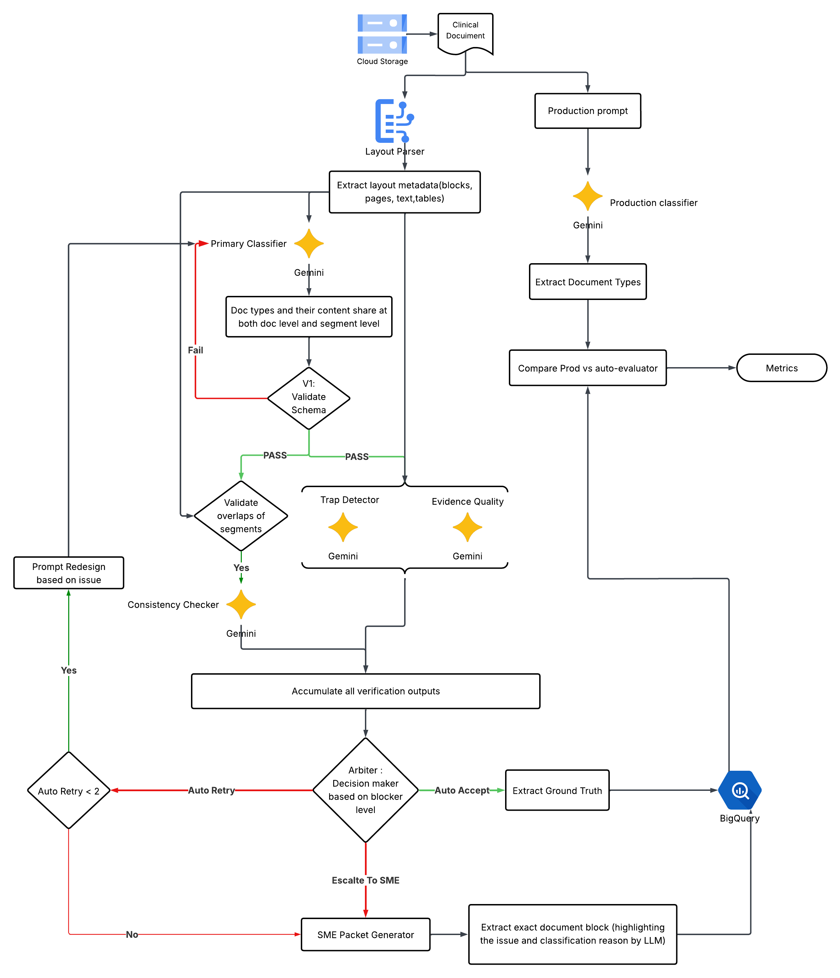
System Design:

Slide 6
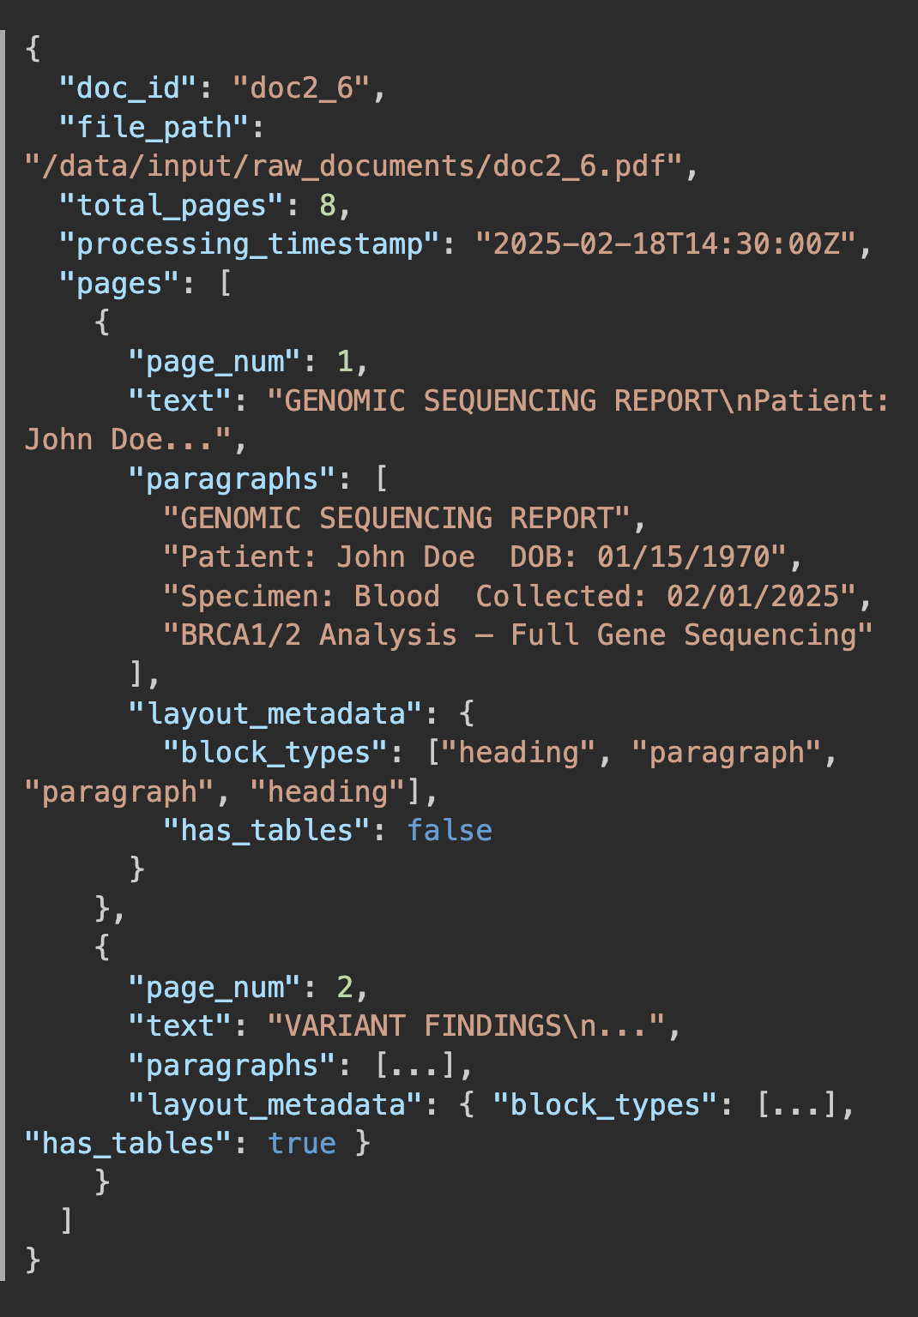
Layout-Processor Output
Before any AI classification happens, the PDF must be converted into structured content.
We use a layout-aware processor that extracts:
paragraph blocks
heading blocks
table structures
page spans
ordered paragraphs per page
Context of para
This produces a structured DocumentBundle used by all downstream LLM calls.
Notes:
Without layout awareness, document structure collapses; with it, we can segment content correctly, label sections precisely, and extract exact problem areas — forming the backbone of accurate multi-label classification. For each document type we classify as we talked before anchors, evidence, segment coverage these are tied with document types . Without that we cant say our primary classifier is it correct or is the evidence correct and also helps in making sme review easy as it can locate the exact chunk .

Slide 7
How Layout Processor Helps:
Reliable metrics for coverage, document type share, and evidence quality.
Anchor-based traceability and navigation.
Pinpointed evidence retrieval.
Context-rich SME review focusing on the troubled chunk.
Notes:
Reliable metrics for coverage, document type share, and evidence quality: Structured layout output lets us compute segment coverage and document-type distribution accurately. It also enables precise evidence verification against the original source, improving quality scoring.
Anchor-based traceability and navigation: Stable layout anchors (page, paragraph ID, coordinates, etc.) link outputs to the exact source location. We use these anchors to validate whether a document type is following to our core logic rules.
How Layout Enables Precise SME Context
Because we store structured paragraphs per page:
We can:
locate the exact evidence snippet
retrieve surrounding paragraphs
reconstruct the precise chunk causing disagreement
In SME interface we can retrieves nearby paragraphs for review context

Slide 8
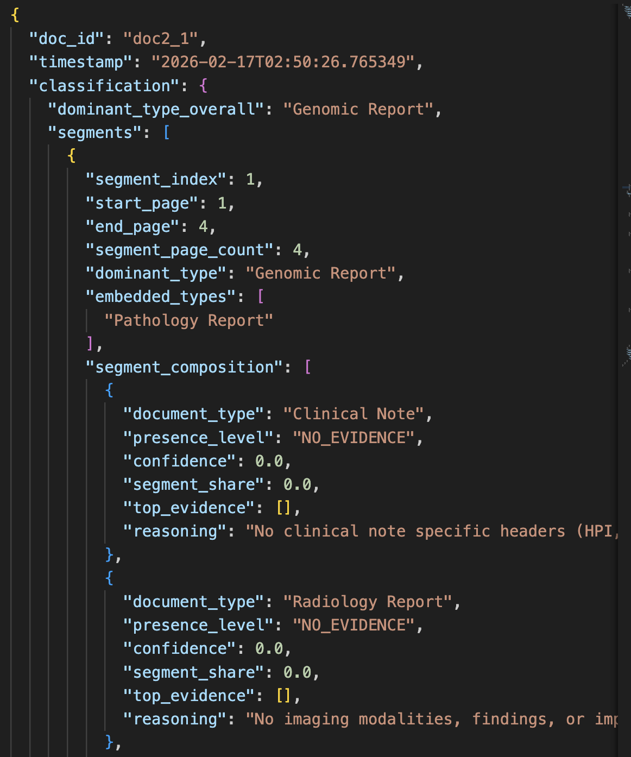
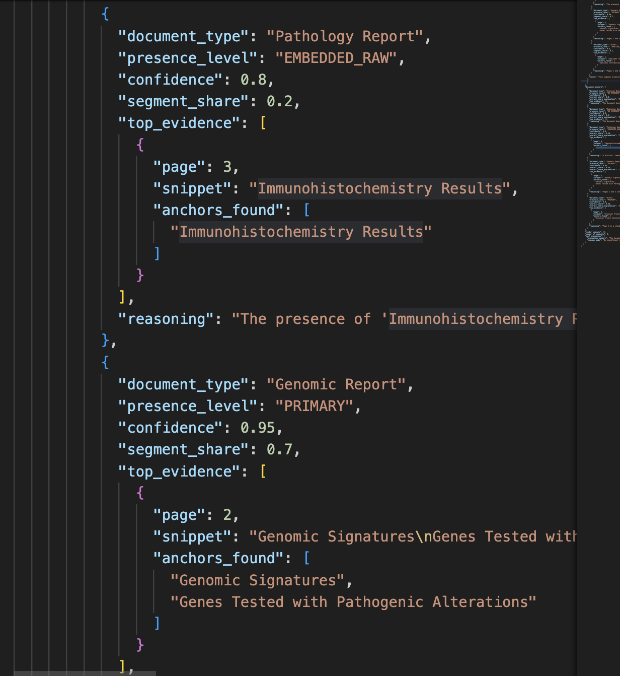
Primary Classifier :
Core Mechanism adopted is segment based Classification.
Primary LLM Output Includes
Segmented page ranges
Dominant type per segment
Composition of ALL document types
Document Mixture
Confidence scores
Evidence snippets + anchors
Vendor signals
Notes:
The primary LLM classifier does more than just assign one label.
Instead, it breaks the document into logical segments and classifies each one.
So what is a segment?
A segment is a group of consecutive pages in the PDF that belong to the same logical content block.
It is NOT just a page. It is NOT the whole document.
It is a continuous section where the document type stays mostly consistent.
For every segment, it evaluates all document types, even those not present.
It also produces evidence snippets and anchor keywords showing exactly what text supported its decision.
This is important because later LLM verifiers will use these snippets to verify whether the reasoning is actually valid

Slide 9
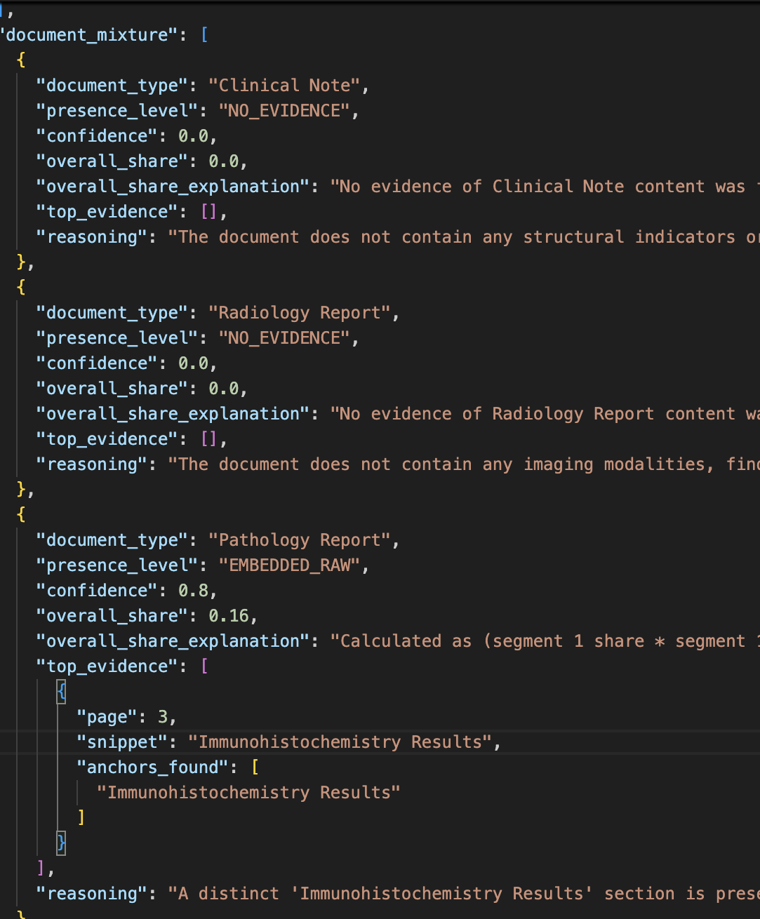
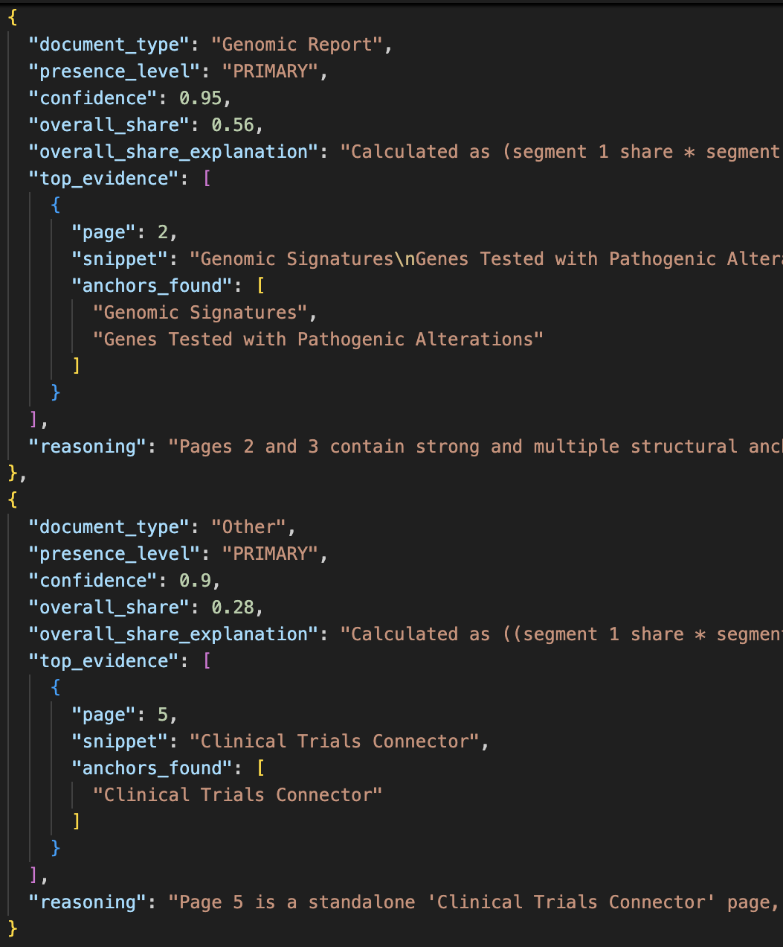
Document Mixture:
Document Mixture is the overall breakdown of document types across the entire PDF.
It summarizes:
which document types appear in the file
how strongly they appear
what percentage of the document they occupy
Each type includes:
presence level
confidence
overall share
supporting evidence
Notes:
Segments tell us what is happening locally in different parts of the document, but document mixture tells us what the document looks like overall.
Clinical PDFs are rarely just one report. They often contain a main report plus attachments, specimen information, administrative pages, or embedded pathology sections.
So instead of forcing the system to choose only one label, we calculate a full breakdown showing how much of the document belongs to each type.
For example, in this case, most of the document is a genomic report, but there is also some embedded pathology content and an administrative page.
The mixture aggregates all of that into a single summary view.
This summary is extremely important because the system later uses it to decide the dominant document type for the entire PDF.
Verification agents also check whether this mixture logically matches the segment data. If the mixture says genomic is dominant but no segment shows genomic content, that would be flagged as inconsistent.
So document mixture is basically the final global truth about the document composition.

Slide 10
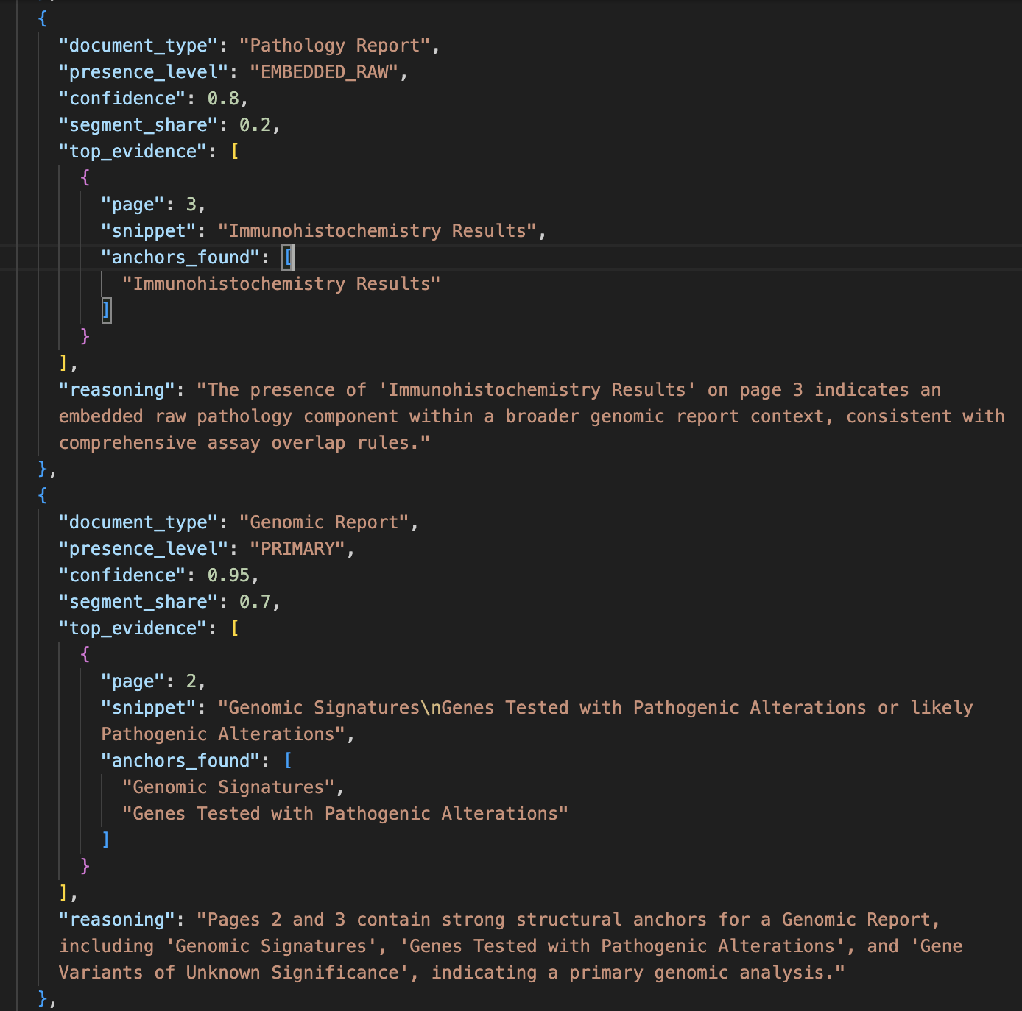
Why Presence Levels Matter
Presence Levels
PRIMARY
EMBEDDED_RAW
MENTION_ONLY
NO_EVIDENCE
Notes:
Presence levels describe the strength of a document type’s presence in the content. They show whether it is the primary report, embedded material, a minor mention, or not present at all.
For example, a clinical note might contain an embedded pathology report. Or a genomic report might briefly mention clinical history.
If we forced the model to choose only one label, we would lose this nuance.
Presence levels allow the system to represent real-world document mixtures.
This also enables downstream verification.
For example, if something is marked PRIMARY, we expect strong evidence. If it’s just a mention, weak evidence is acceptable.
So presence levels aren’t just labels — they guide how strict verification should be.

Slide 11
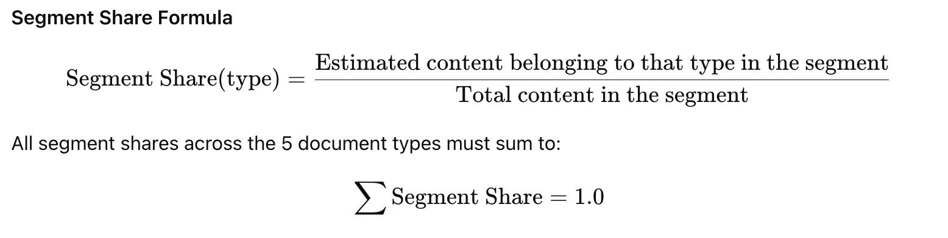
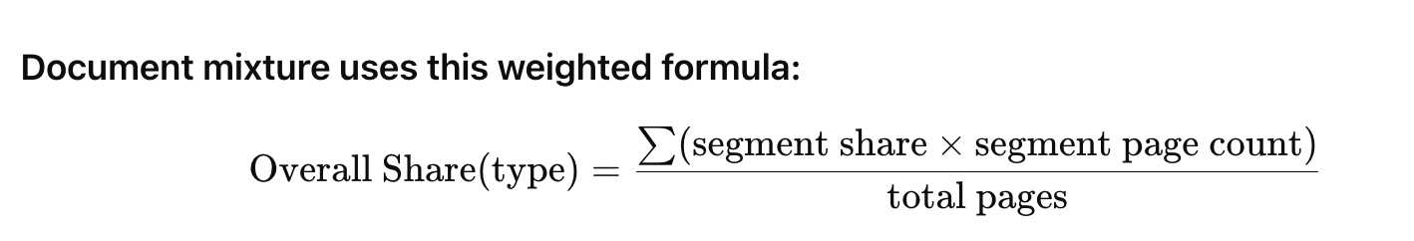
Anchors, Evidence, and Segment Share
Evidence snippet → actual supporting text
Anchors → keywords expected on page
Segment share → fraction of segment belonging to type
Notes:
The evidence snippet tells us exactly what text the model used.
The anchors are keywords that should also appear on that page.
Segment share is basically the model’s estimate of how much of a segment belongs to each document type.
For example, if a segment contains mostly genomic report content but also some embedded pathology data, the model might assign something like 70% genomic and 20% pathology.
All the shares inside a segment must add up to exactly one, meaning we’re distributing the entire segment across all possible document types.
This number is important because later agents use it to check logical consistency, compute the overall document mixture, and determine which document type truly dominates the file.
Verification agents reuse all three.
For example, the evidence validator checks whether the snippet actually exists in the real PDF text. If it doesn’t, that means the model hallucinated.
And when SMEs review a case, they don’t need to search the document manually — the snippet and anchors point them straight to the relevant section.

Slide 12
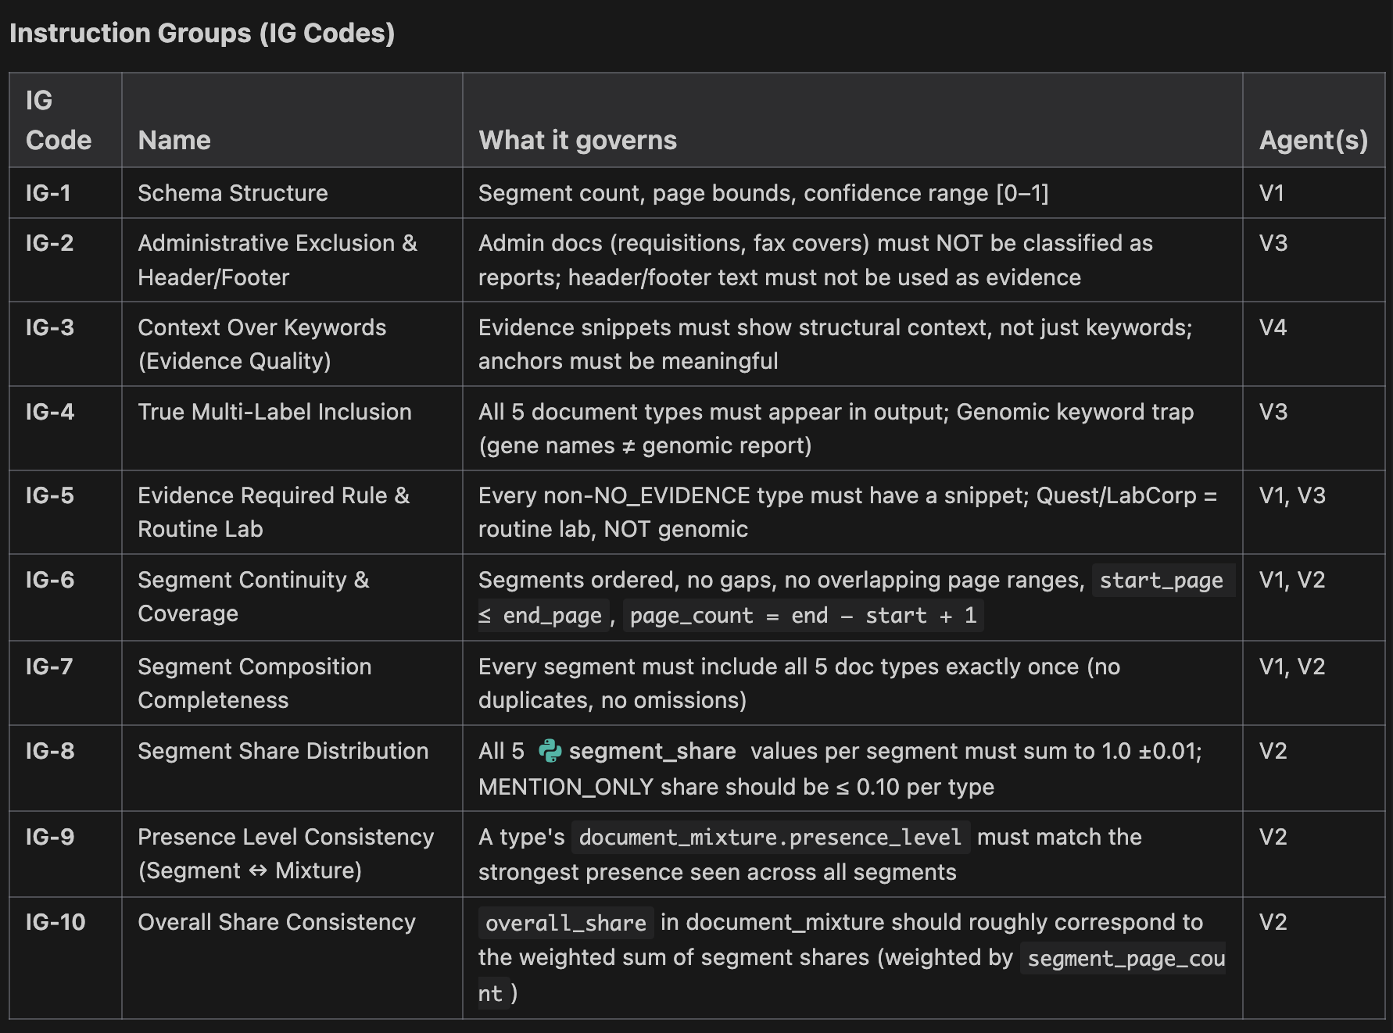
Instruction Grouping Core structural and logical requirements for every classification
Notes:
Instead of relying only on the LLM’s judgment, we defined a structured validation framework.
Our system validates outputs using two rule layers:
The first layer is what we call Instruction Groups, or IG codes.
These are the foundational rules that every classification output must follow. They define what a valid output even looks like — things like whether segments cover all pages, whether shares sum to 100 percent, and whether evidence snippets exist for claimed document types.
You can think of IG codes as the system’s grammar and math rules.

Slide 13
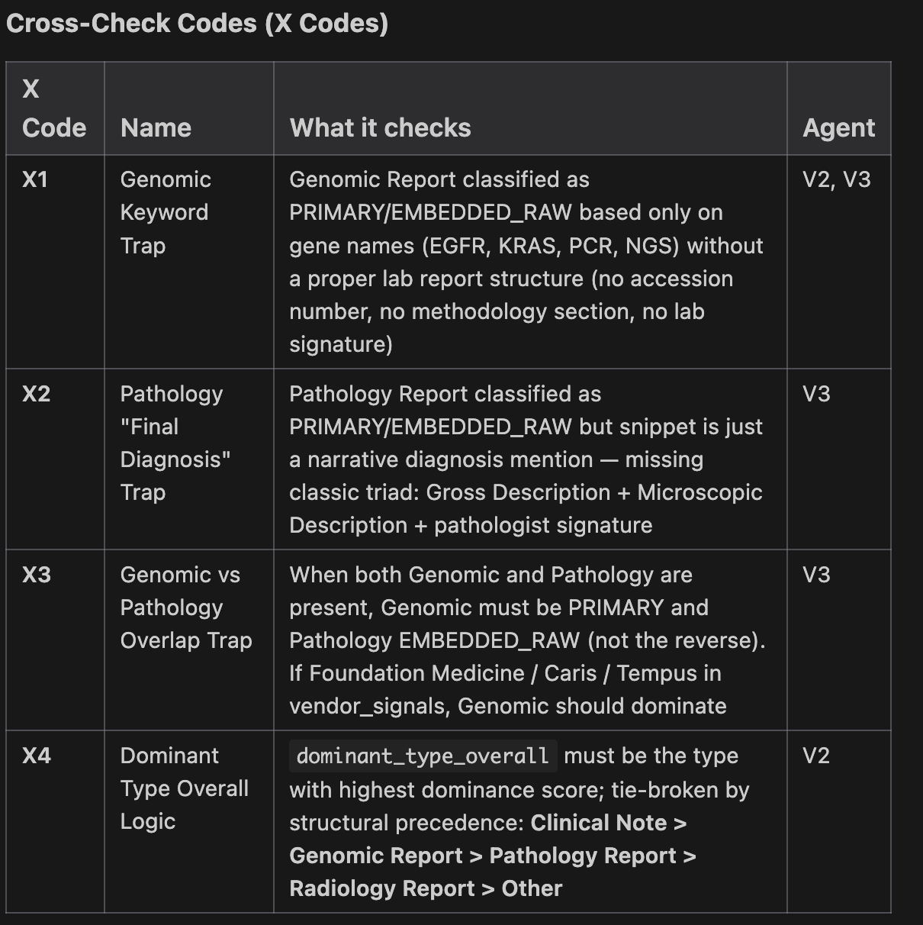
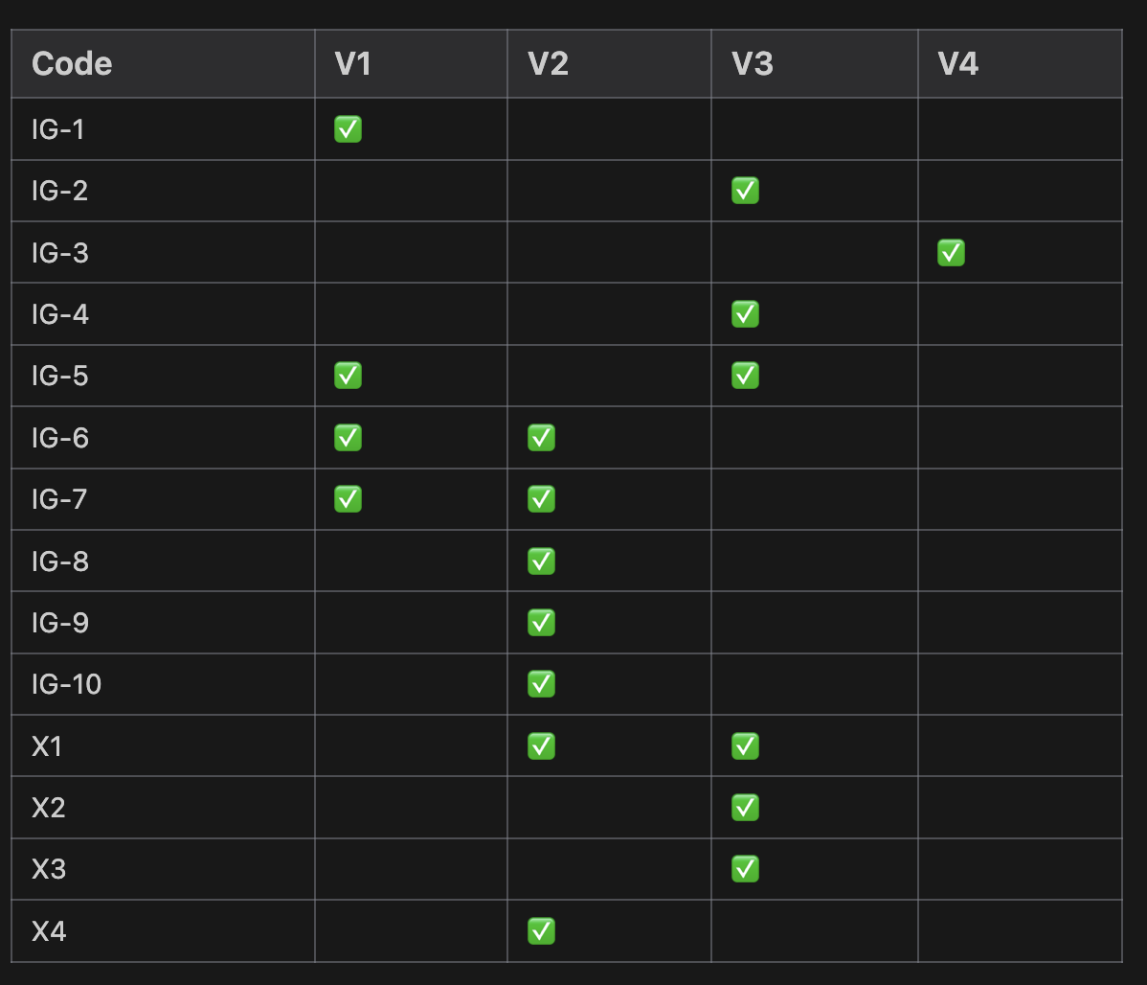
Cross Check codes Domain-specific validation traps to prevent clinical misclassification
Notes:
Then we have the second layer, the Cross-Check Codes, or X codes.
These are domain-specific safety traps.
For example, just seeing gene names like EGFR or KRAS does not automatically mean the document is a genomic sequencing report. Similarly, seeing the phrase “final diagnosis” does not automatically mean it is a pathology report.
These traps exist because medical documents often contain misleading keywords that could confuse a generic language model.
So IG codes enforce structural correctness, while X codes enforce clinical correctness.
Together, they ensure that the system is not just syntactically valid but also logically and medically accurate.

Slide 14

Verification Philosophy
Why Multiple Verification LLM Calls Exist:
LLMs are:
strong at language
weak at structured math
prone to hallucination
unaware of domain traps
So Each LLM call specializes in one kind of failure.
One checks structure.
One checks math consistency.
One checks clinical domain traps.
One checks evidence authenticity.
Notes:
Instead of asking one model to do everything, we divided verification into multiple LLM calls.
Each LLM calls specializes in one kind of failure.
One checks structure.
One checks math consistency.
One checks clinical domain traps.
One checks evidence authenticity.
This separation makes the system much more robust than a single large prompt.

Slide 15
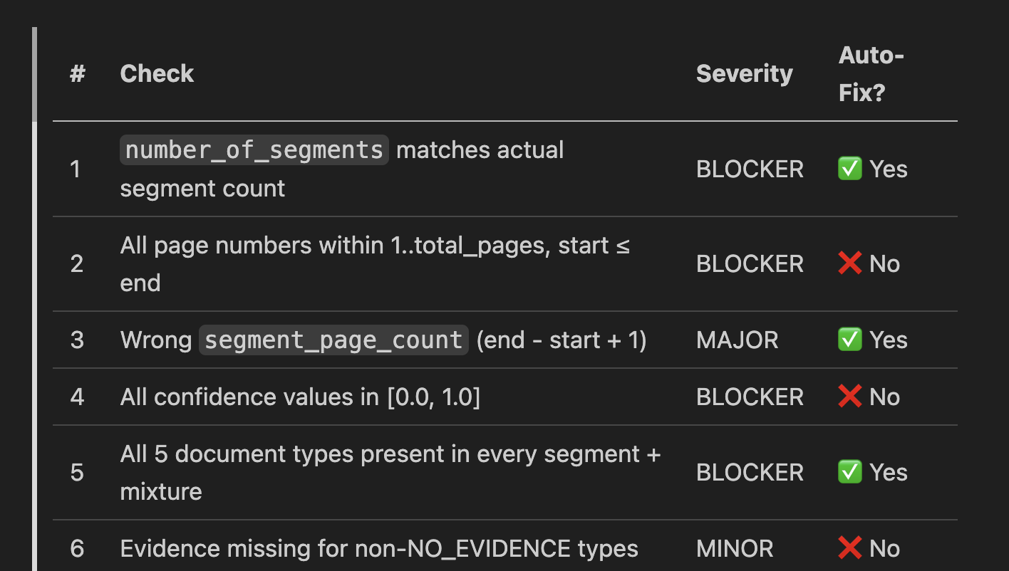
V1 Schema Validator (Rule based)
V1 catches structural corruption — if the LLM hallucinated a segment count or returned out-of-range page numbers, V1 stops the pipeline immediately with a BLOCKER before any LLM call.
Checks Structural Validity
segment counts match
page ranges valid
all document types present
confidence values in range
Notes:
V1 is like a syntax checker.
Before spending money on expensive LLM checks, we first confirm the output structure is even valid.
If the model claims there are 3 segments but only returns 2, that’s a structural error.
Catching these early saves cost and prevents downstream confusion.

Slide 16
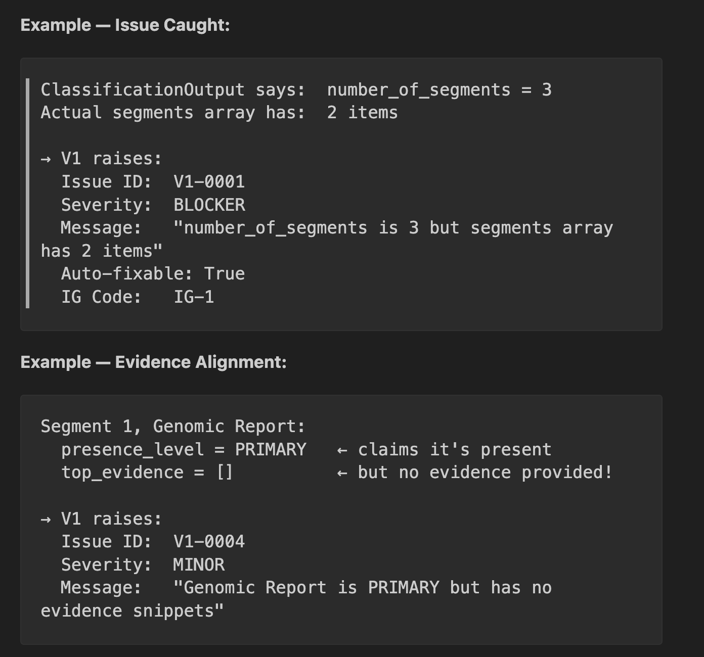
V1 Issue Capture:
Notes:
By using Instruction Groups we basically flag the issues :
V1 checks whether the classification output is structurally valid before any deeper medical or semantic validation happens.
In the first example, the model reports three segments but only returns two in the array. This mismatch breaks downstream logic like page coverage and share calculations, so it is flagged as a blocker.
In the second example, a document type is marked as PRIMARY but no evidence snippet is provided. Since PRIMARY implies strong presence, supporting text must exist, so this is flagged as an evidence alignment issue.
Overall, V1 ensures the output structure is trustworthy before the system proceeds to more expensive verification steps.

Slide 17
V2: Internal Consistency Checker Hybrid — fast rules first, then LLM semantic check
Phase 2 - LLM Semantic Check:
Receives: full ClassificationOutput JSON + complete page text for every segment
Checks: does the text actually match the labels? (e.g., segment labelled "Genomic Report" but text is all clinical notes)
Returns: JSON array of issues
Phase 1 – Rule based
Check | Condition | Severity
Segment shares sum | Each segment's 5 segment_share values must sum to 1.0 ±0.01 | MAJOR (auto-fix)
Mixture shares sum | All 5 overall_share values must sum to 1.0 ±0.01 | MAJOR (auto-fix)
Page range overlap | No two segments can share the same page | BLOCKER
Notes:
First, it runs fast rule-based checks to confirm that segment shares sum correctly, mixture values add up properly, and page ranges do not overlap.
Once the structure passes these checks, V2 performs a semantic validation using an LLM.
In this step, the LLM compares the actual segment text with the assigned document type to confirm the classification makes sense in context.
For example, if a segment is labeled as a genomic report but the text only contains routine lab values, the semantic check will flag this mismatch.
So V2 combines mathematical validation with content-level reasoning to ensure the classification is both structurally correct and semantically believable.

Slide 18
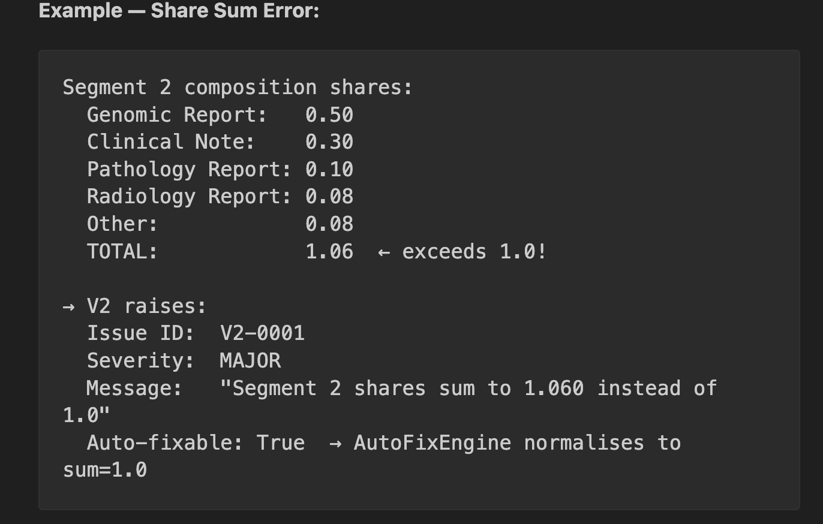
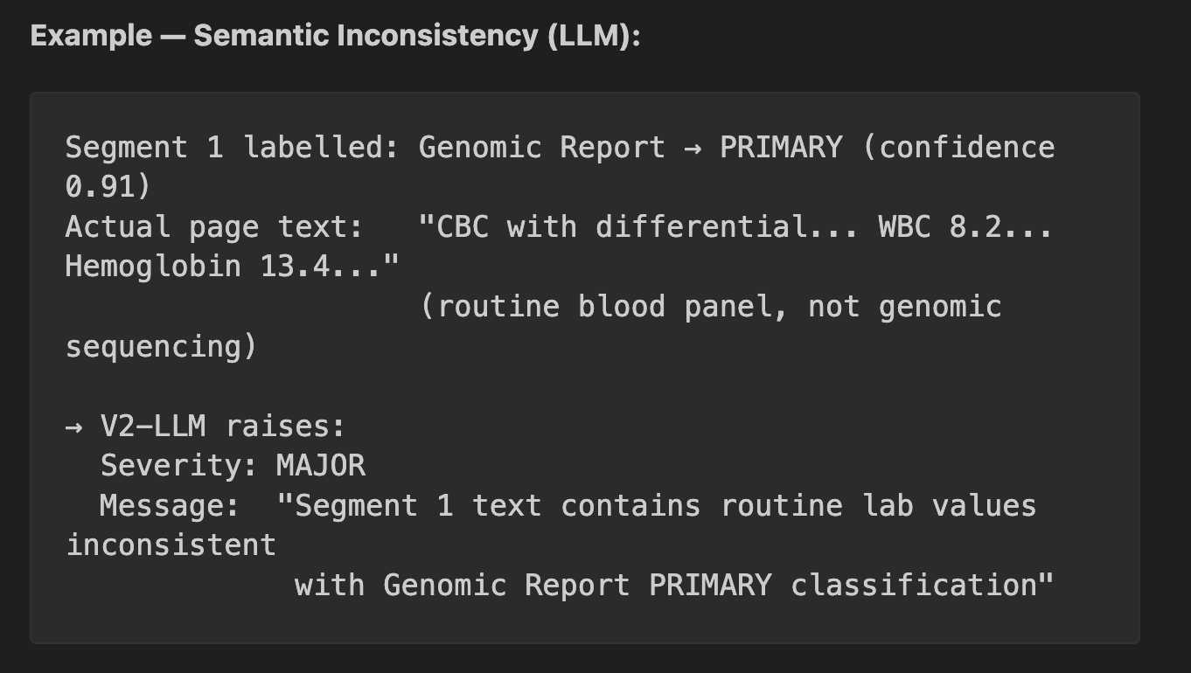
Examples for V2:

Slide 19
V3: Trap Detector & Rule Violation Checker
Rule-Based Trap Detection
detects misleading keywords or vendor signals
prevents routine labs being classified as genomic
prevents admin forms being classified as reports
ensures dominant-type precedence rules
Containing evidence In Header/footer
LLM Contextual Analysis
reviews document text context beyond keywords
detects subtle domain mismatches
flags classifications that look plausible but are clinically incorrect
V3 encodes clinical domain knowledge as rules. A general-purpose LLM might not know that Quest Diagnostics = routine lab, not genomic lab. These rules prevent systematic misclassification.
Notes:
V3 focuses on catching classification traps.
Some documents contain keywords that could easily mislead the classifier. For example, routine lab reports often contain gene-like terms or medical terminology that might look like genomic data.
The first part of V3 uses rule-based checks to catch these known traps, such as vendor signals or administrative keywords that should not be classified as clinical reports.
Then V3 runs an LLM contextual analysis.
This step looks at the actual document context instead of just individual keywords. It evaluates whether the overall narrative and structure of the text really supports the assigned document type.
This helps catch subtle mistakes where the classification might look reasonable on the surface but is actually incorrect when reading the full context.

Slide 20
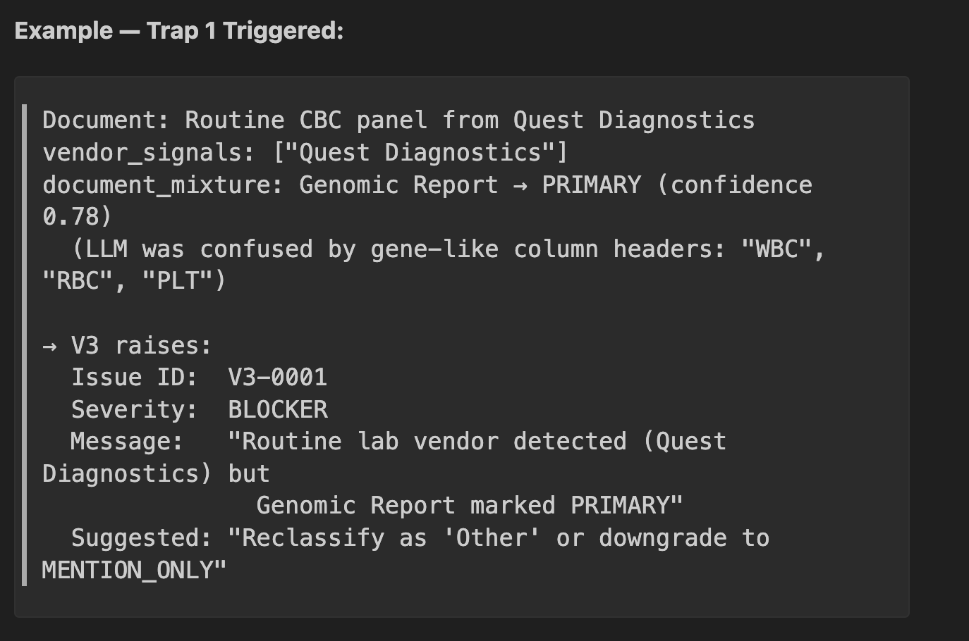
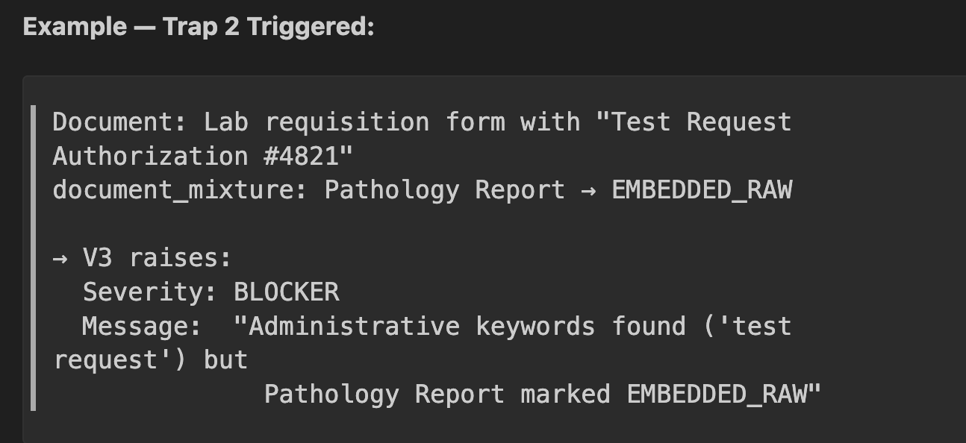
Examples for V3:

Slide 21
V4 Evidence Validator
Task | What it checks
Evidence quality | Are snippets specific, relevant, appropriately sized?
Snippet verification | Does the snippet text actually exist in the PDF page?
Anchor verification | Are the anchors_found strings present on the claimed page?
Fabrication detection | Any snippet that cannot be found in the source PDF
It does NOT trust the classifier's evidence - it independently cross-checks every evidence snippet against the raw PDF text extracted by Document AI.
V4 is the hallucination detector. LLMs sometimes generate plausible-sounding evidence snippets that don't actually exist in the document. V4 catches this by comparing against the raw Document AI output.
Notes:
It does not trust the classifier’s evidence.
Instead, it independently checks the raw extracted PDF text and verifies whether the snippet really appears there.
If not, that means the model invented supporting evidence, which is a serious failure.
This step is what makes hallucination detection possible.

Slide 22
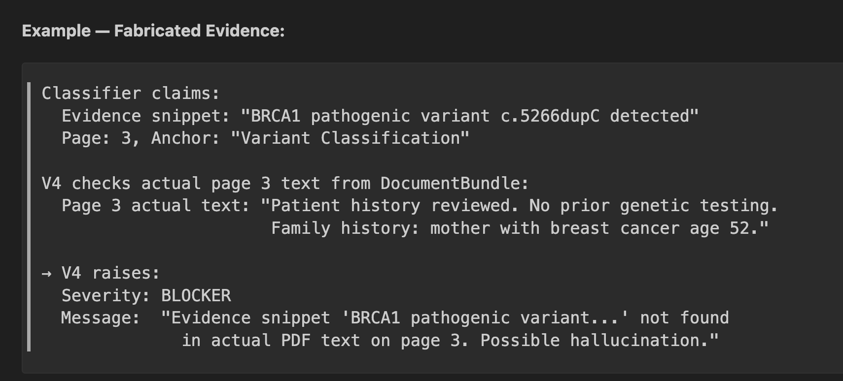
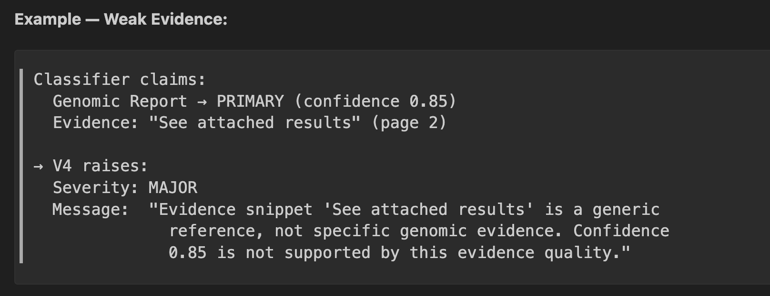
Examples for V4:

Slide 23
V5: Decision Maker (Arbiter) – Rule Based
Priority | Condition | Decision | Rationale
1 | Any BLOCKER issue | 🔴 ESCALATE_TO_SME | Critical failure — cannot auto-correct
2 | ≥ 3 MAJOR issues | 🔴 ESCALATE_TO_SME | Too many errors for auto-correction
3 | ≥ 2 non-fixable MAJOR | 🔴 ESCALATE_TO_SME | Requires human judgment
4 | ≥ 1 non-fixable MAJOR | 🔴 ESCALATE_TO_SME | Conservative — any human-needed issue escalates
5 | 1–2 fixable MAJOR | 🟡 AUTO_RETRY | AutoFixEngine can correct these
6 | Only MINOR issues | 🟢 AUTO_ACCEPT | Tolerable, doesn't affect validity
7 | No issues | 🟢 AUTO_ACCEPT | Perfect output
8 | Ambiguous | 🔴 ESCALATE_TO_SME | Safety fallback
Final Decision
AUTO_ACCEPT
AUTO_RETRY
ESCALATE_TO_SME
Based on issue severity and fixability.
V5 is intentionally conservative even a single non-fixable MAJOR issue triggers escalation. The system is designed to over-escalate rather than silently accept a bad classification.
Notes:
After collecting all issues, V5 makes the final call.
If problems are small, we accept.
If problems are fixable automatically, we retry.
If there’s any serious doubt, we escalate to a human expert.
Importantly, this agent is rule-based, not LLM-based, so its decisions are deterministic and auditable.

Slide 24
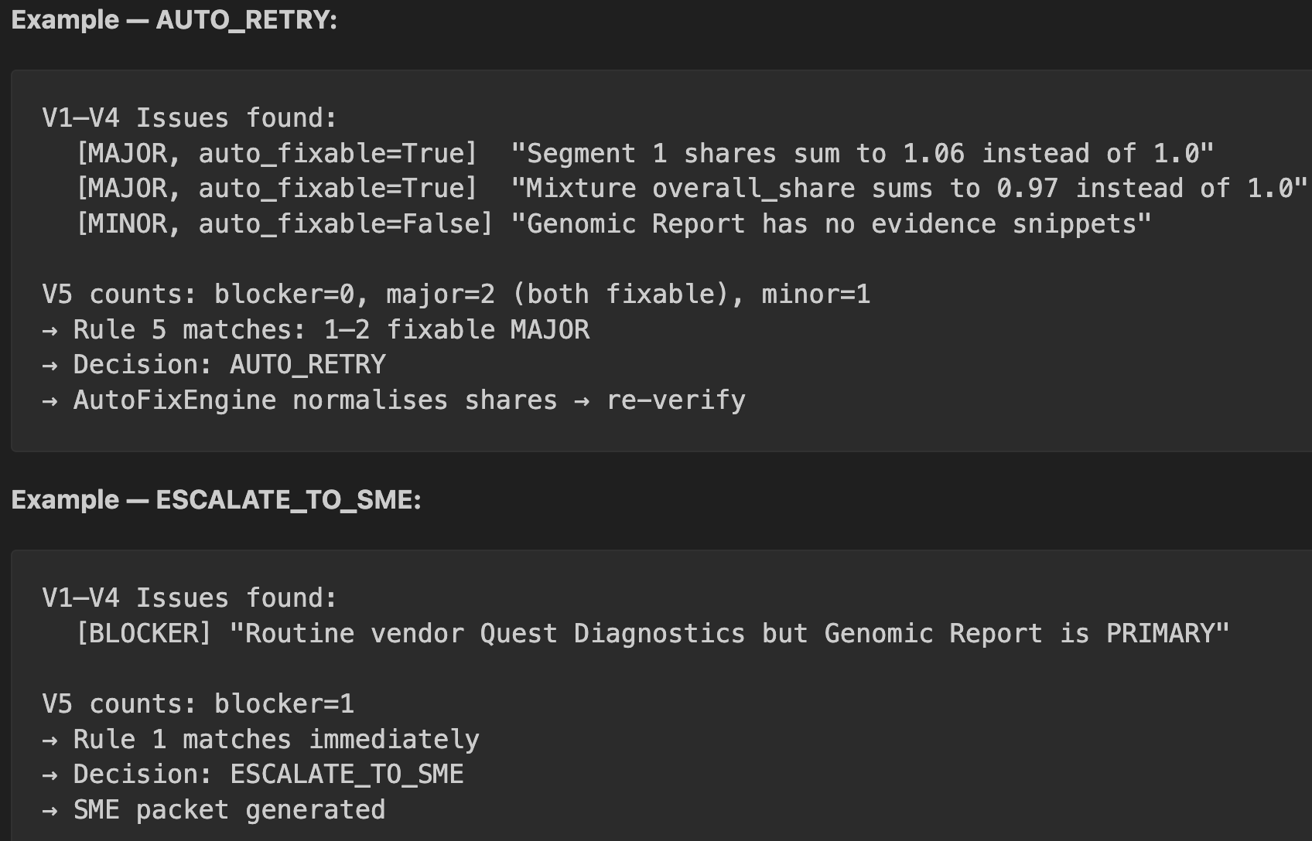
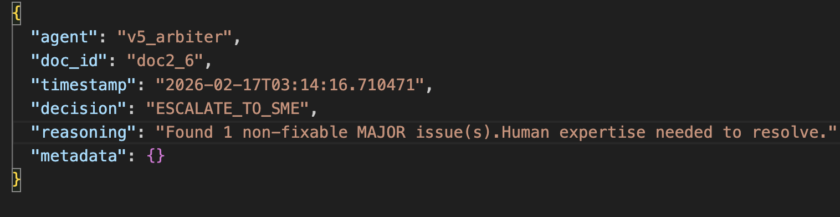
V5 Output and examples:

Slide 25
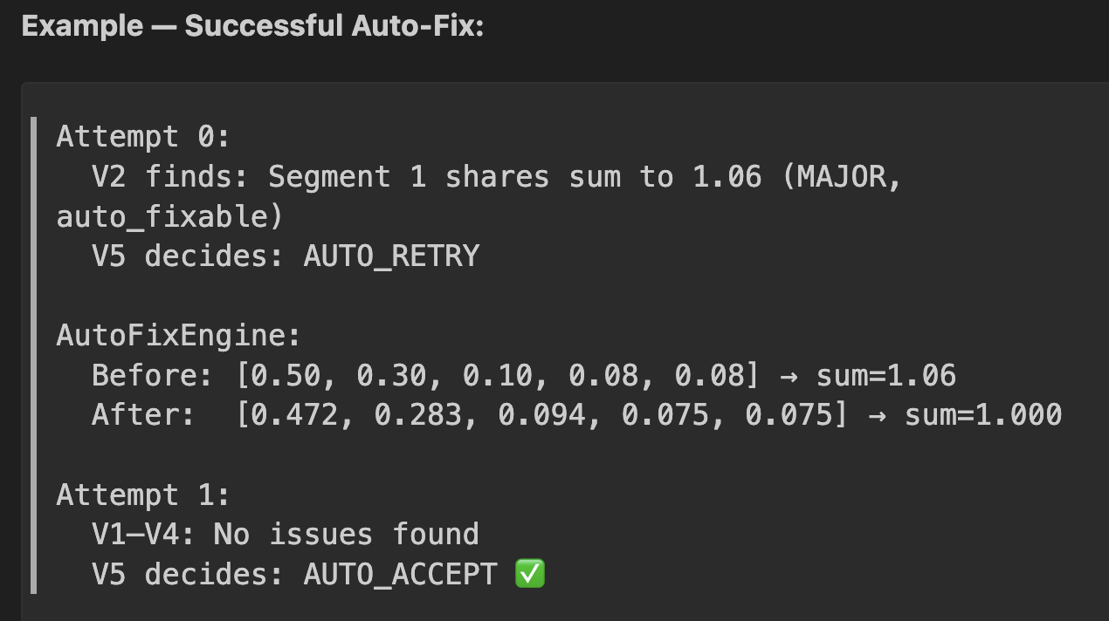
Retry and Auto-Fix Loop
Automatic Retry Mechanism
fixes mathematical share errors, less severity errors in traps, Low evidence mismatch
reruns verification
detects cycles
max retries = 2
Cycle detection uses an MD5 fingerprint of segment boundaries, dominant types, and share values; if the same state repeats, the system stops retrying and escalates to SME to avoid wasted LLM calls.
Notes:
Some problems don’t require human review.
For example, share values might not sum exactly to one.
The system automatically normalizes them and retries verification.
If the output doesn’t improve after two attempts, we stop and escalate.
This prevents infinite loops while still resolving simple issues automatically.
During retries, the system tracks a fingerprint of the classification state, including segments, dominant labels, and share values. If the same fingerprint appears again, it means the fixes aren’t improving the output, so the system immediately stops retrying and escalates for human review instead of wasting more verification attempts.

Slide 26
SME Packet Generation
When verification cannot auto-accept or auto-fix:
The system generates a structured SME review packet containing:
document metadata (file, pages, ID)
full classification output (segments, mixture, evidence)
all validation issues sorted by severity
production comparison (if available)
document bundle path for context lookup
Packet is saved and queued for SME review.
Notes:
When the system determines that a document cannot be safely auto-accepted or automatically fixed, it escalates the case to a subject matter expert.
Instead of sending the raw PDF and expecting the SME to investigate manually, the system generates a structured review packet.
This packet contains everything needed for decision-making, including the classification output, supporting evidence, and a prioritized list of issues explaining exactly why the document was escalated.
Because the packet already highlights the problematic segments and reasoning, the SME does not need to search through the entire document.
This significantly reduces review time and ensures that human effort is focused only where it is actually needed.

Slide 27
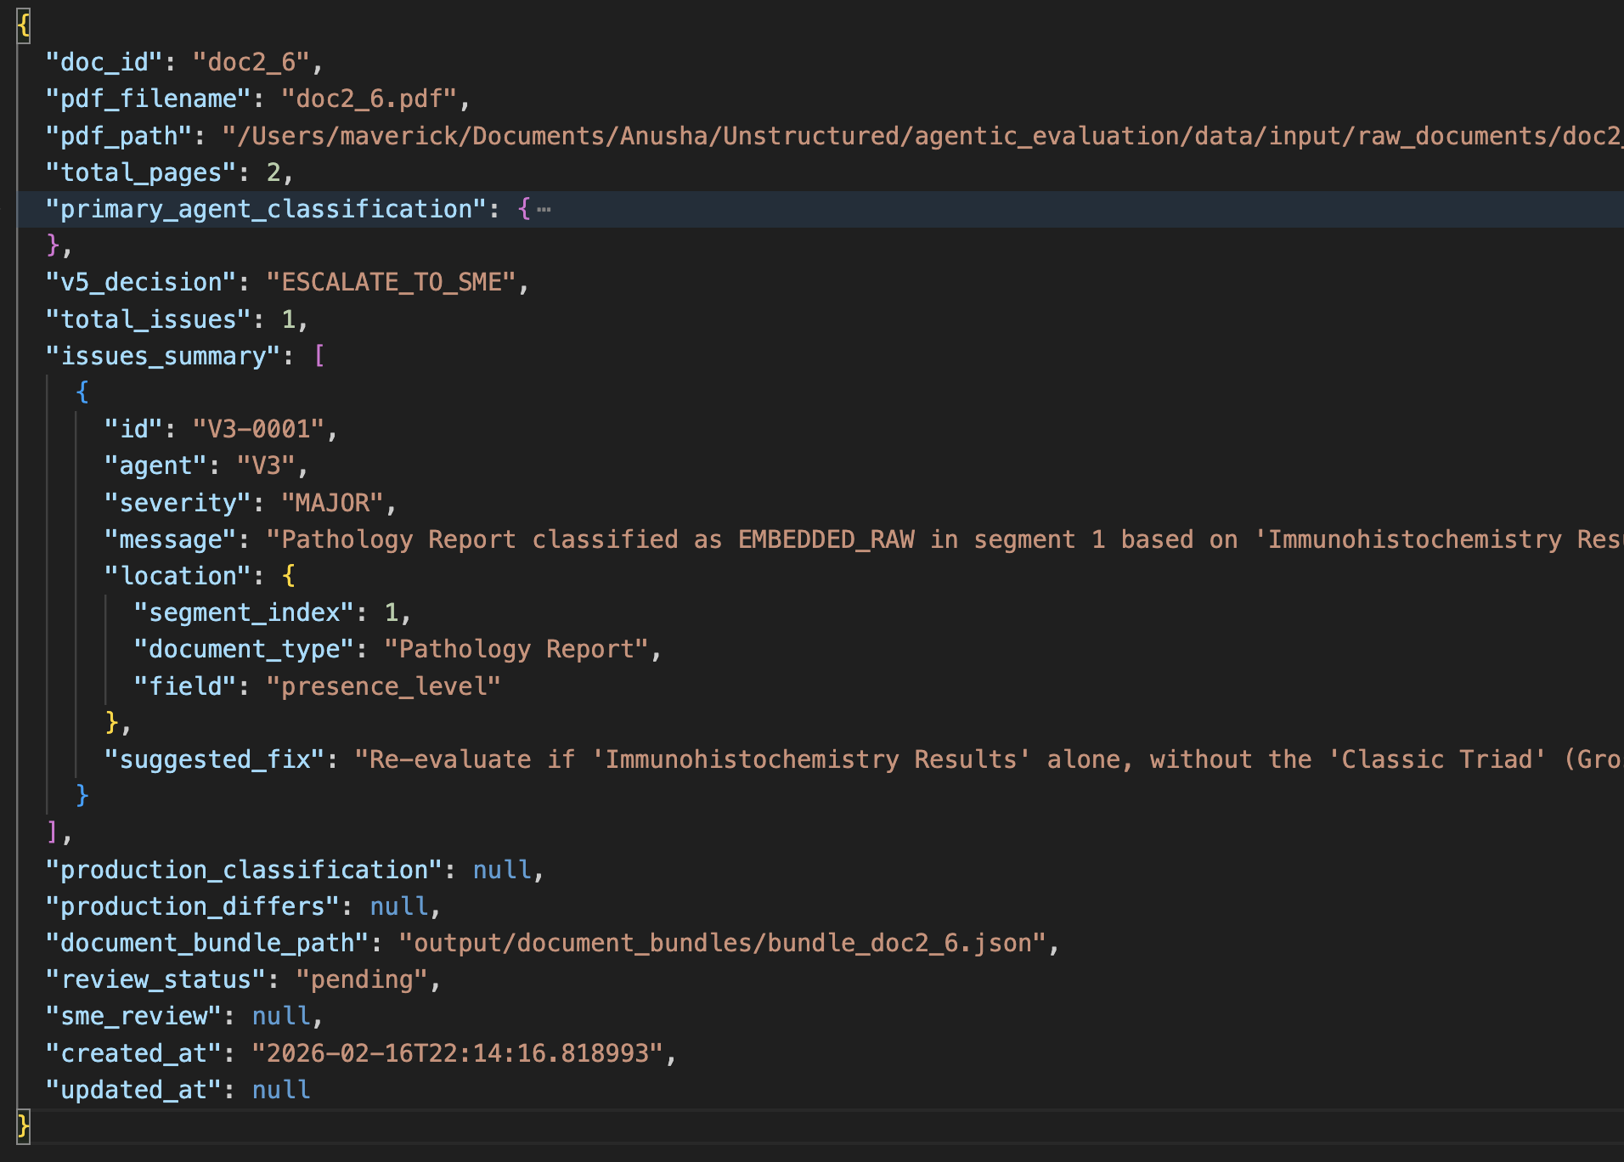
Example: SME Packet

Slide 28
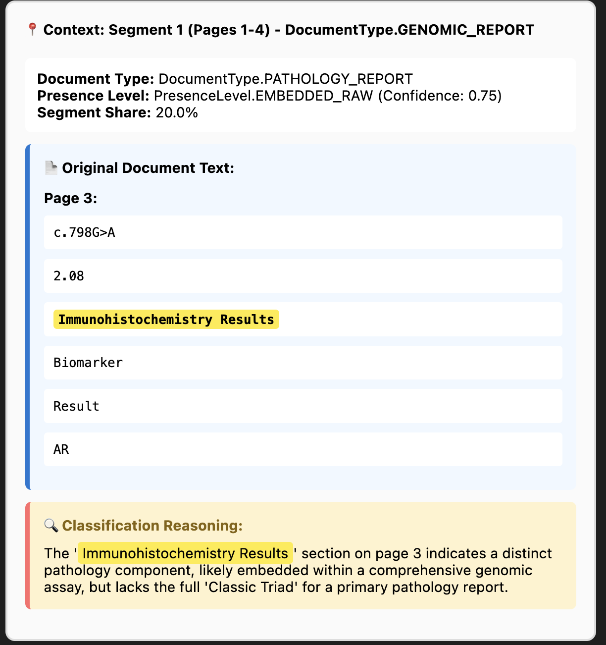
SME Review Interface
How SMEs Review Only Problem Areas
Interface shows:
troubled segment only
reasoning from classifier
evidence snippet
surrounding paragraph context
Notes:
This is where we dramatically reduce SME workload.
Instead of reading the full 8-10 page document, the SME sees only the exact segment with the issue.
They also see the snippet, anchor keywords, and nearby paragraphs.
This means they can validate the classification in seconds instead of minutes.
This design turns SME review from full-document reading into targeted verification.

Slide 29
Flagged Important Design Decisions
Design Choice | Reason
V1 runs first, no LLM | Catch structural errors cheaply before spending on LLM calls
V2 skips LLM if BLOCKER found | Don't waste API calls on structurally broken output
V3 encodes clinical domain rules | General LLMs don't know Quest = routine lab, not genomic
V4 cross-checks against raw PDF text | Detects LLM hallucination of evidence snippets
V5 is pure rule-based | Deterministic, auditable, reproducible — same input = same decision always
MAX_RETRIES = 2 | Prevents infinite fix loops; 3 attempts is enough for mathematical fixes
MD5 cycle detection | Prevents AutoFixEngine from applying the same fix repeatedly with no effect
Conservative escalation | Even 1 non-fixable MAJOR → escalate. Over-escalate rather than silently accept bad output
SME sees actual PDF text | SME can independently verify evidence, not just trust the LLM's claims

Slide 30
Future Enhancement: Feedback Learning & Prompt Optimization Agent
Feedback-Driven Learning Agent (Planned)
Before escalating to SME, the agent will:
search historical SME-reviewed cases for similar issue patterns
reuse prior SME corrections to generate automatic fix prompts
prevent repeated known issues from reaching SMEs
For new documents or when a new practices onboards:
detect recurring validation failures
identify which rules or checks are consistently failing
pinpoint sections of the classifier prompt needing adjustment
Result
only new classification patterns reach SMEs
faster onboarding of new practices
continuous prompt improvement
reduced manual review workload

Slide 31

Thank You

